Slide 1
Snort
Intrusion Detection System

Slide 2

Snort IDS/IPS
Is the foremost open source intrusion prevention system that uses a series of rules that help define malicious network activity and use those rules to find packets that match against them and generates alerts.(snort.org)
Can be deployed inline to stop these packets, as well.
Three Primary Uses:
Packet sniffer
Packet logger
Network Intrusion Prevention System

Slide 3

IDS Configurations
Configured setting to network ip 10.0.2.15 enp0s3
Can be changed with command sudo dpkg –reconfigure snort

Slide 4
Rule Tuning
Generated rules under local rules:
FTP
Ping
Nmap scanning
SSH
DOS attack
SSH brute force alert/drop

Slide 5
Attack Simulation and Logging
Nmap scanning
Ping
SSH scanning
FTP attempt
DOS attack
SSH Brute Force
/home/tekadmin/log (log file)
Snort –v (sniffer mode)
Sudo snort –c -q –l /home/log/ snort.conf –A console –I enp0s3 (quite NIDS mode)
Snort –de – l /home/log/ (Packet mode)
Open logs in Wireshark for analysis

Slide 6
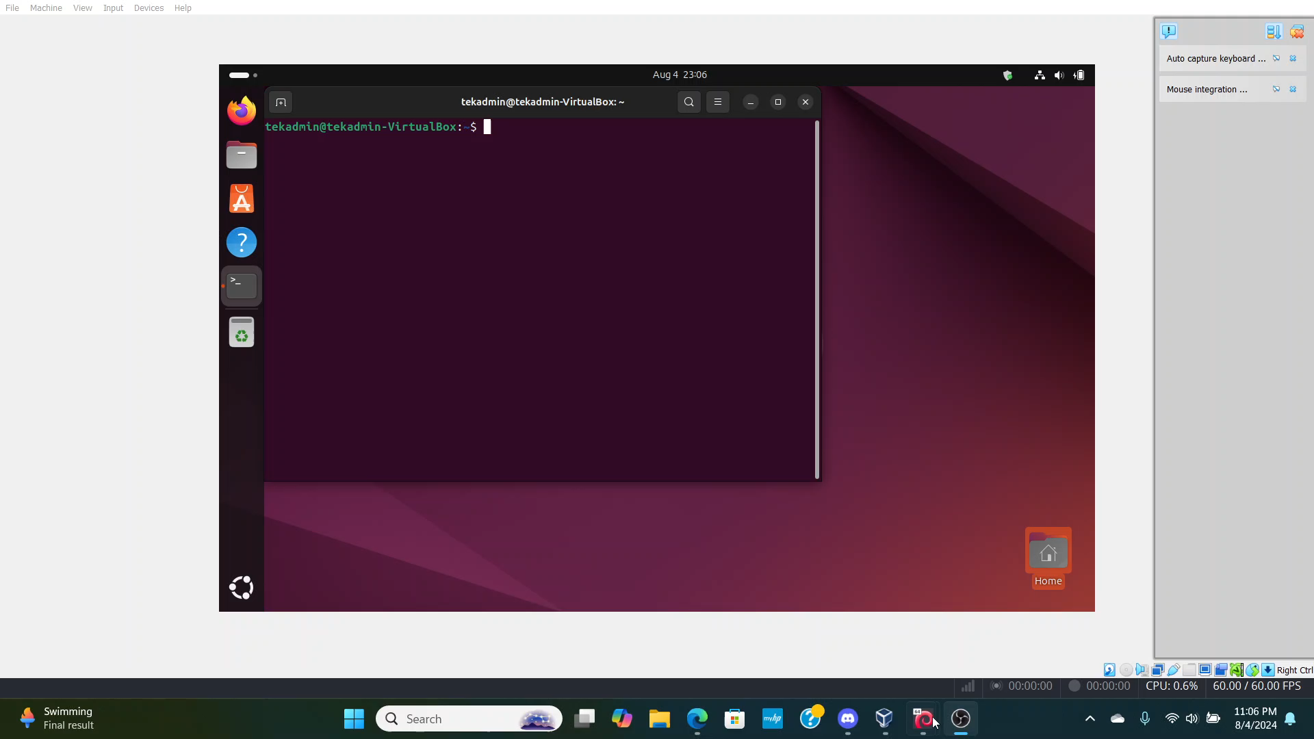
Project Video

